Slide 1

Analysing spatial dynamics
using R and QGIS
CDCS by Ki Tong (ktong2@ed.ac.uk)

Slide 2
Today’s programme:
Introduction to Point Pattern Analysis
Density-based vs distance-based analysis (relationship with 1st order and 2nd order dynamics)
Kernel Density Estimation (KDE)
Nearest Neighbour Analysis (NNA)
Ripley’s K-Function
Conclusion
Notes:
There are three typical types of spatial data analysis: areal geostatistical and point patterns. We could also look at how people move between locations. Point patterns are more common and more fundamental.

Slide 3

Introduction to point pattern analysis
Tobler's first law of geography.
Clustering is a “manifestation” of some form of relationship between observations.
To understand the underlying causes, understanding whether observations cluster is key.
Everything is related to everything else, but near things are more related to each other (Tobler, 1970)

Slide 4
How to see if observations cluster?
Point-pattern analysis (PPA) - detect clusters or patterns across a set of points
There are three main approaches to PPA (Qiang et al, 2020)
Descriptive statistics
Density-based approach
Distance-based approach
Notes:
Point pattern analysis (PPA) studies the spatial distribution of points (Boots & Getis, 1988). As outlined above, PPA uses the density, dispersion and homogeneity in our point datasets to assess, quantify and characterise its distribution.
Over the last fifty years, various methods and measurements have been developed to analyze, model, visualize, and interpret these properties of point patterns

Slide 5
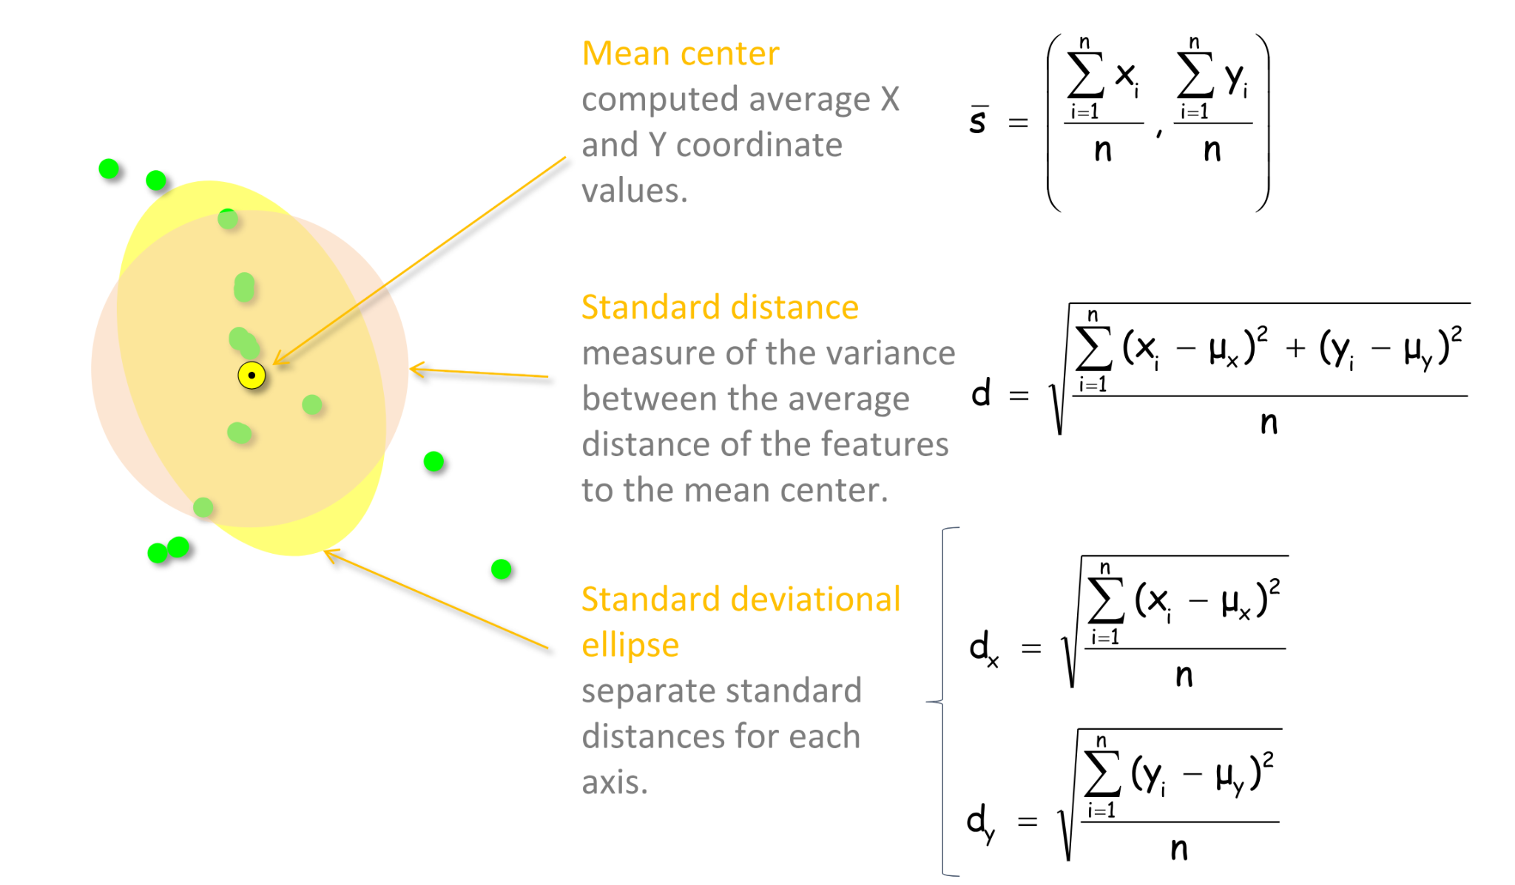
Descriptive statistics
Overall distribution
Centrography
Central tendency/ dispersion
Notes:
Before examining formally models of spatial intensity, we often utilise descriptive statistics to help us understand the overall distribution of points. This approach using descriptive method to understand distribution is known as centrography. The method of centrography includes techniques such as the mean centre, standard distances and standard deviational ellipse. These measures help provide insight into the central tendency and dispersion of a point pattern, offering a useful starting point for exploring spatial variation.
These were popular techniques before the platforms like qgis or fast computers were widely available as hand calculations were relatively simple. Now with the widely available QGIS, we could do it pretty quickly. Let’s hope on to QGIS and see how to do it.

Slide 6
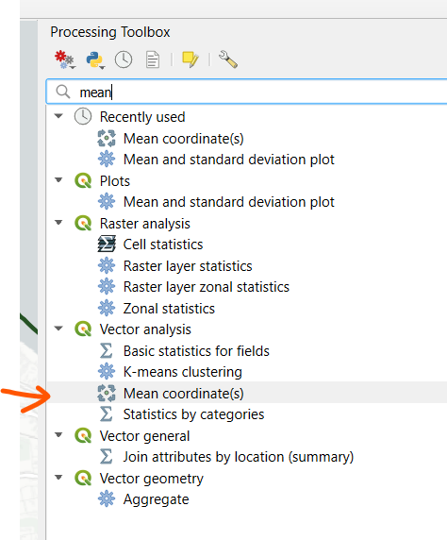
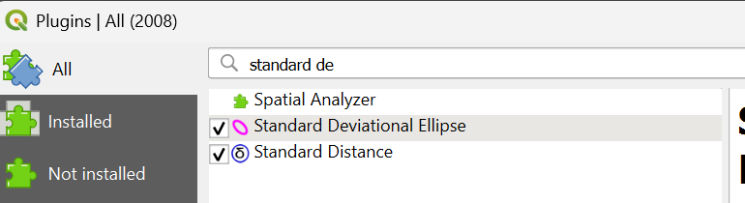
Descriptive statistics
Mean coordinates
Standard distance
Standard deviational ellipse
Notes:
Before examining formally models of spatial intensity, we often utilise descriptive statistics to help us understand the overall distribution of points. This approach using descriptive method to understand distribution is known as centrography. The method of centrography includes techniques such as the mean centre, standard distances and standard deviational ellipse. These measures help provide insight into the central tendency and dispersion of a point pattern, offering a useful starting point for exploring spatial variation.
These were popular techniques before the platforms like qgis or fast computers were widely available as hand calculations were relatively simple. Now with the widely available QGIS, we could do it pretty quickly. Let’s hope on to QGIS and see how to do it.
You can calculate mean centres pretty easily as it’s embedded in the processing toolbox.
But for standard distance and standard deviational ellipse, you will need a plugin to do that.
There might be issues with versions,
Python
C:\Users\ktong\AppData\Roaming\QGIS\QGIS3\profiles\default/python/plugins\SDEllipse\
Change self.dlg.progressBar.setValue(0.0) to self.dlg.progressBar.setValue(0)

Slide 7
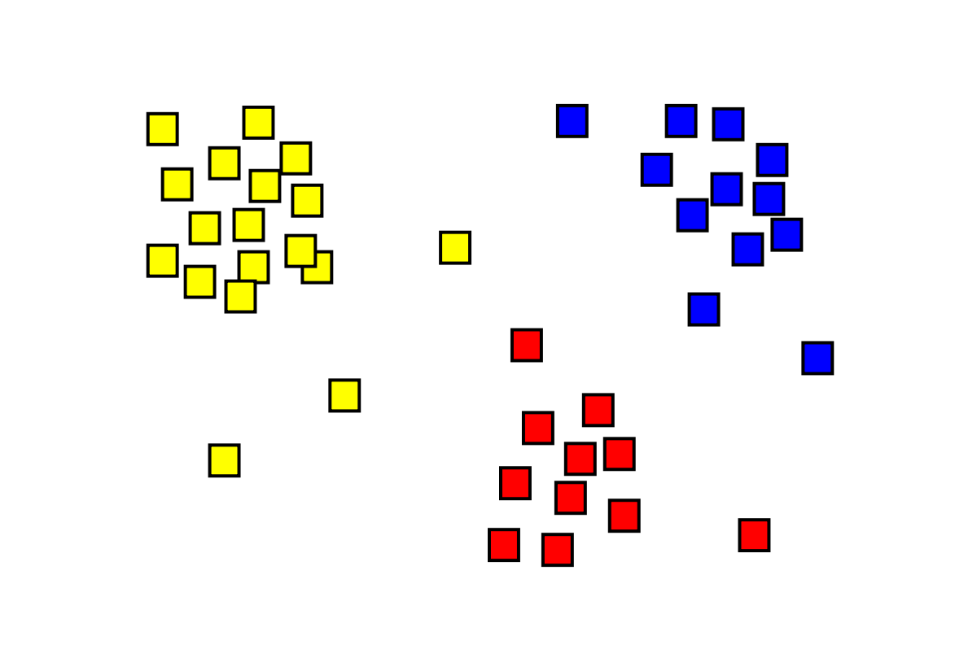
Descriptive statistics
Overall distribution
Centrography
Central tendency/ dispersion
Limited in communicating the pattern of clustering
Notes:
Descriptive statistics are however somewhat limited in what they can communicate about a dataset’s pattern.
For example, the pattern you see at the bottom, descriptive statistics will give you a mean point somewhere in the middle which doesn’t quite represent the clustering pattern of the three groups. Therefore, we need more sophisticated techniques.
Standard distance and standard deviational ellipse measure how spread out point patterns are. Standard distance measures how dispersed a group of points is around its mean center but it doesn’t indicate direction. Standard deviational ellipses to calculate separate standard distances for two perpendicular axes, which then enables one to understand the direction of effects.
Outliers can be identified and accounted with descriptive methods. You also can’t visualize point patterns to observe the distribution of clusters spatially. More sophisticated techniques are required.
More powerful techniques have been developed to explore point patterns, which will either be density-based or distanced-based, depending on the spatial properties the technique is considering (Gimond, 2020).

Slide 8
Density-based & distance-based analysis
Density-based
known as the first order property of a dataset
The variation in the individual locations of the points in the dataset across the study area.
Focus on density.
E.g. Back at times when COVID just started, were places for people with positive test results went to (just before they caught it) more common in some parts of town than others?
Distanced-based
Known as the second order property of a dataset
The influence of one observation on another (i.e. interactions).
Focus on dispersion.
E.g. Covid is contagious. Among those who caught Covid, were some individuals more likely to be the ‘mega host’ of the virus and spread to other people?
Notes:
Density-based methods focus on the first-order properties of a dataset, i.e. the variation in the individual locations of the points in the dataset across the area of interest, and will characterise our dataset’s distribution accordingly in terms of density.
As its name suggested, density-based analysis shows you the area that has the highest frequency.
Distanced-based methods focus on the second-order properties of a dataset, i.e. the interactions between points within our data and whether they appear to have influence on one another and form clusters, and will characterise our dataset’s distribution accordingly in terms of dispersion.

Slide 9
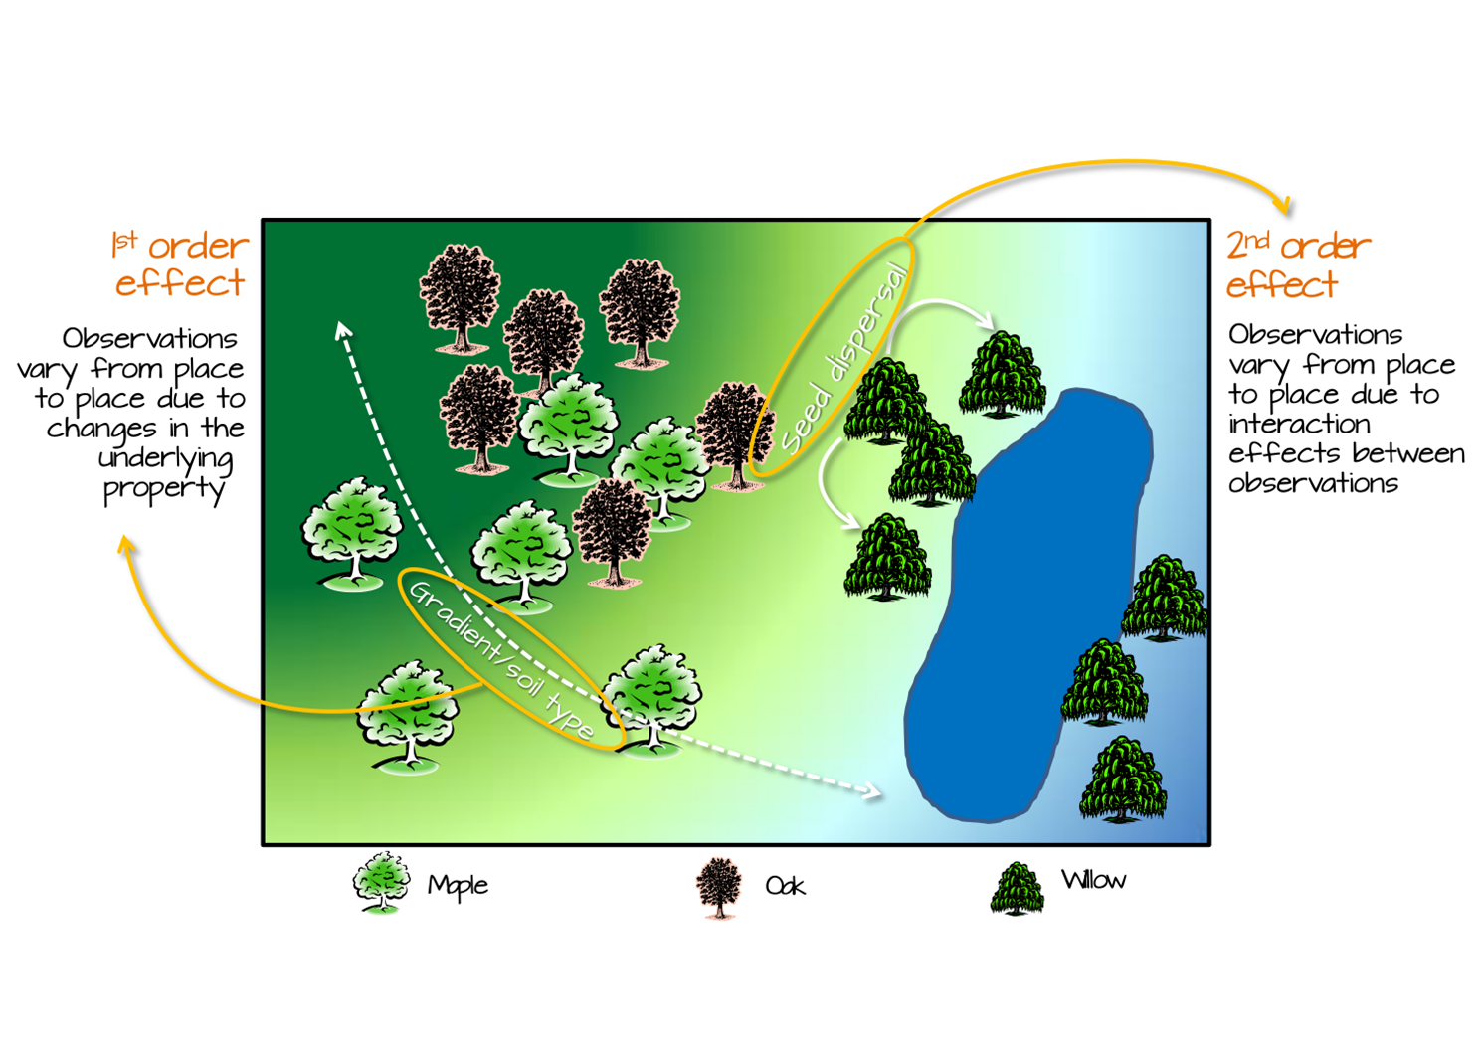
Example for first and second order dynamics
Notes:
Based on the picture that you can see here, what are some of the first order effects that you can see?
Similarly, what are some of the second order effects that you can see?

Slide 10
Example for first and second order dynamics

Slide 11
First and second order dynamics
Tree distribution can be influenced by first order effects such as:
Elevation
Gradient
Spatial distribution of soil characteristics
This, in turn, changes the tree density distribution across the study area.
Tree distribution can also be influenced by second order effects such as:
Seed dispersal processes.
Access to sunlight (canopies of other trees block light)
Here the process is independent of location and is, instead, dependent on the presence of other trees.

Slide 12
SPATIAL analysis for first and second order effects
The list is not exhaustive, but for the scope of today’s course, we will focus on the following,
First-order effects (Density-based approach)
Kernel density estimation
Second-order effects (Distanced-based approach)
Nearest Neighbour Analysis
Ripley’s K-function

Slide 13
Dataset we will be looking at today
Edinburgh!
Recorded trees within the Council area
Scottish Index of Multiple Deprivation (SIMD)
Areas in Scotland are "struggling" vs which are "thriving.“
1-10 (1 = most deprived; 10 = least deprived (most affluent))
Income: Do people have enough money to live on?
Employment: Are people out of work or unable to work?
Health: How long do people live, and how often are they sick?
Education: Are kids doing well in school and going to university?
Access: How far is the nearest GP, post office, or supermarket?
Crime: How safe is the area?
Housing: Are the homes overcrowded or without central heating?

Slide 14
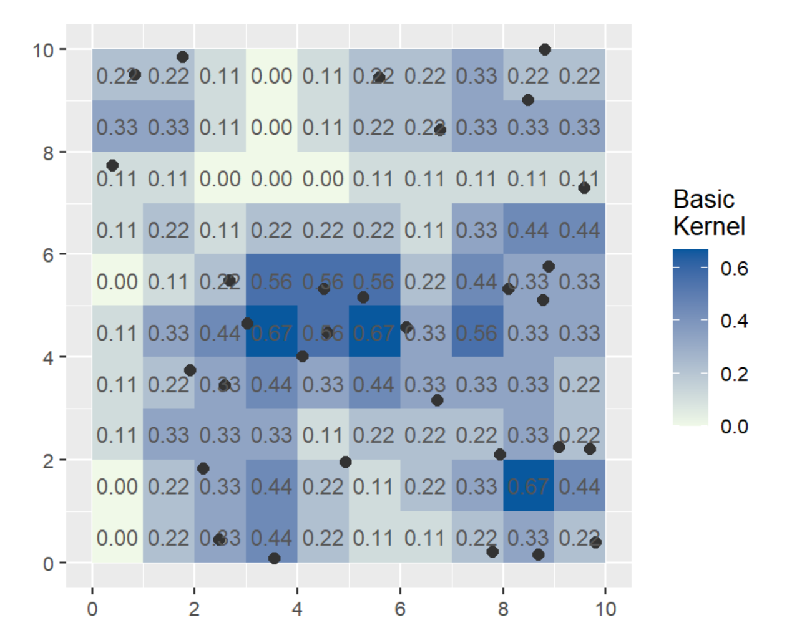
Kernel density estimation
Density-based approach
No. of points within a sub-regions of a study area.
Divide study area into many sub-regions
Sub-regions overlap one another providing a moving sub-region window = kernel
Example
3x3 kernel density map
Equal weight per point
E.g. 0.11 from 1/9
Equal weight per point = basic kernel function.

Slide 15
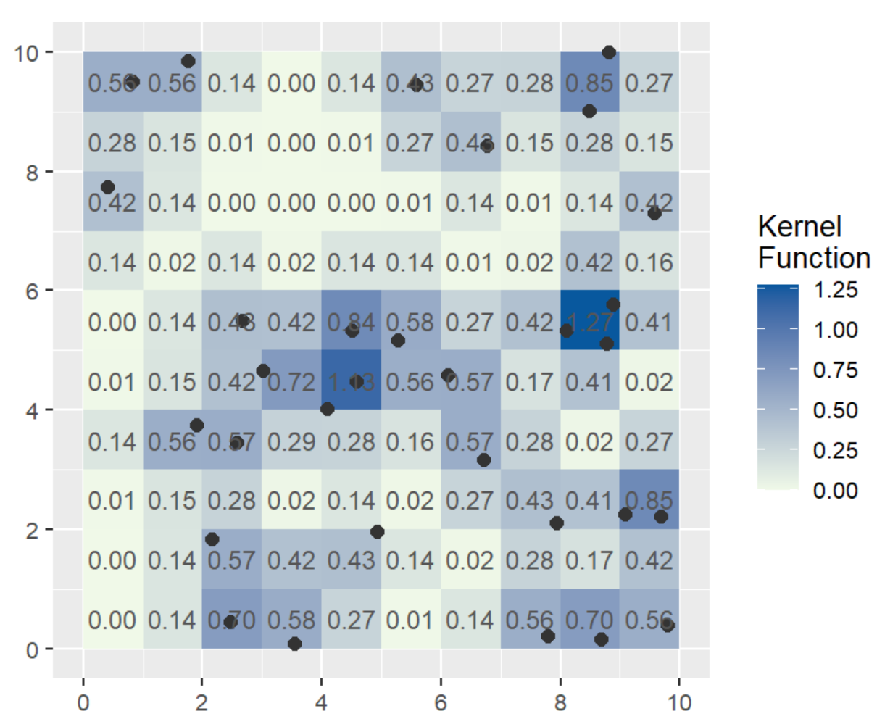
Kernel density estimation
Other kernel functions (assign weights to points that are inversely proportional to distance to kernel centre)
The output will appear as a heatmap.
Other data can be draped over this heatmap (such as vectors for rivers or roads, point scatters of artefacts) to study interactions between sites, features, and phenomena.

Slide 16
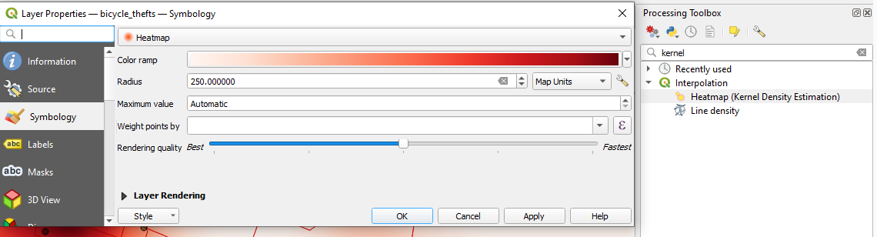
Let’s see how it works in QGIS
To perform KDE in QGIS,
Go to Properties -> Symbology in the “Trees” layer in QGIS.
Select Heatmap.
Select a colour ramp of your choice.
Set Radius to ‘Map Units’ and input 250 (this gives each Kernel a range of 250 metres).
Layer Rendering, select ‘Multiply’ on Blending Mode.
Click ‘OK’
Notes:
Map units = metres
In general, a area size like Edinburgh would

Slide 17
How do we know it’s clustering in a way we anticipated?
Earlier, the density of tree distribution could be affected by elevation.
So, the most intuitive way to examine if trees are “denser” at lower elevations.
Rather than eye-balling, can we visualise these patterns?

Slide 18
How do we know it’s clustering in a way we anticipated?
In a city, trees are typically more densely distributed in areas with lower deprivation. Let’s see if this is the case in Edinburgh.

Slide 19
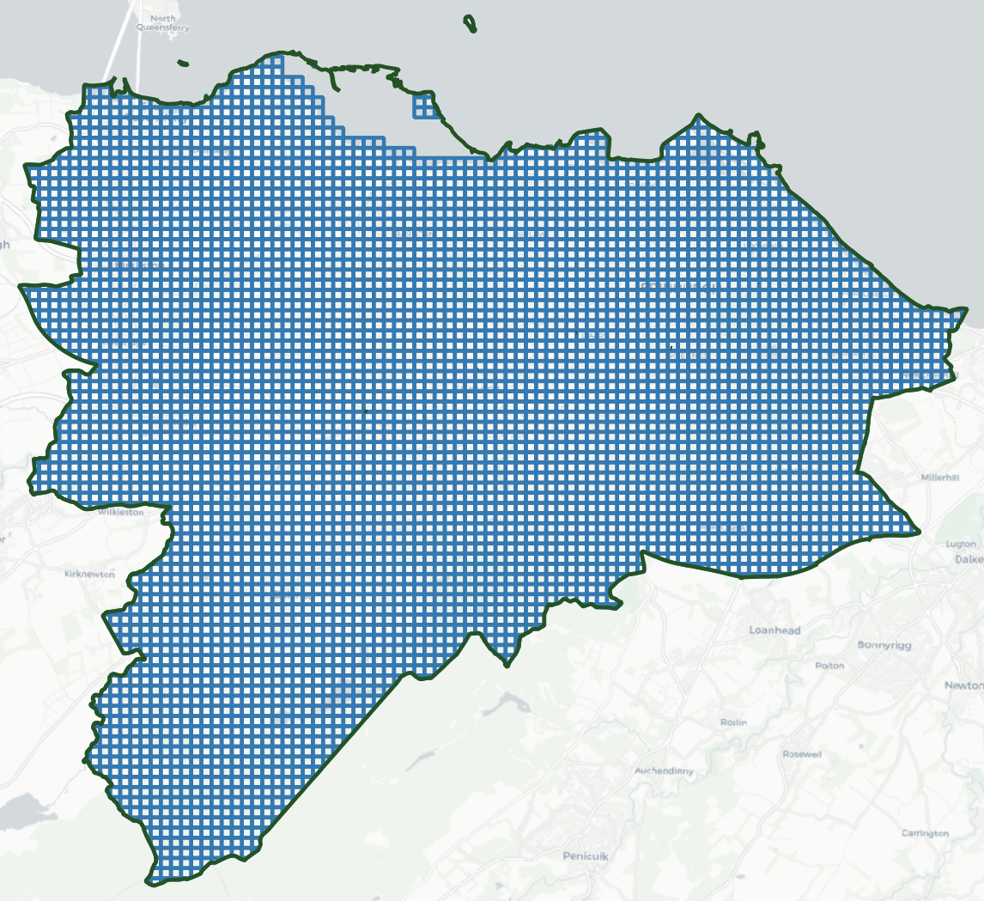
How do we know it’s clustering in a way we anticipated?
Essentially, to see if this is the case (tree density vs income level), we need to see if areas with high income level also has more trees.
To do this, we first divide the area into grids of ‘bins’

Slide 20
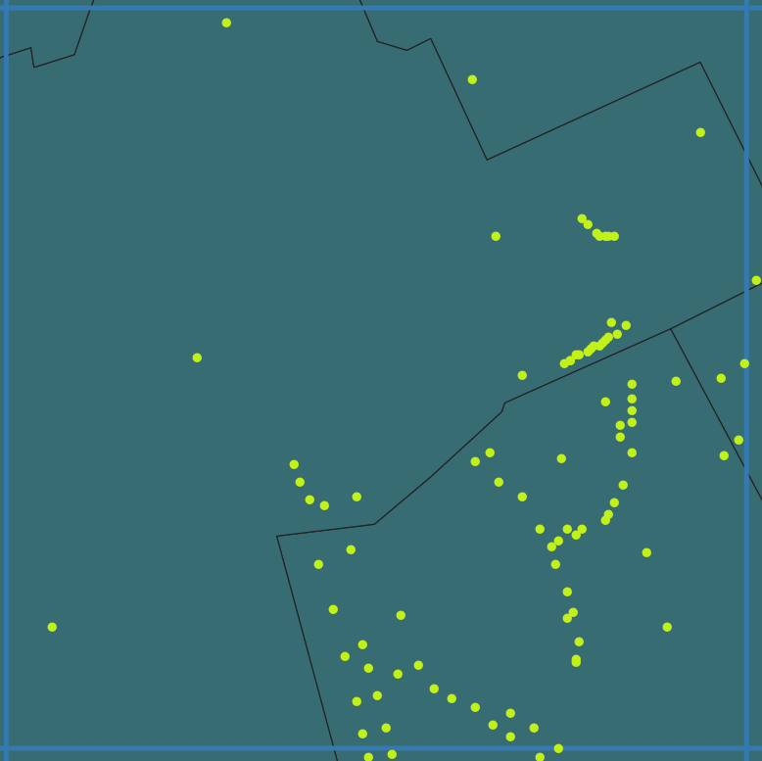
How do we know it’s clustering in a way we anticipated?
Then we count the number of trees in each grid
And then assigns income level to the grid (typically by the largest area
Assign income level (i.e. 10 in this case based on colours)
Count how many points in this grid in total

Slide 21
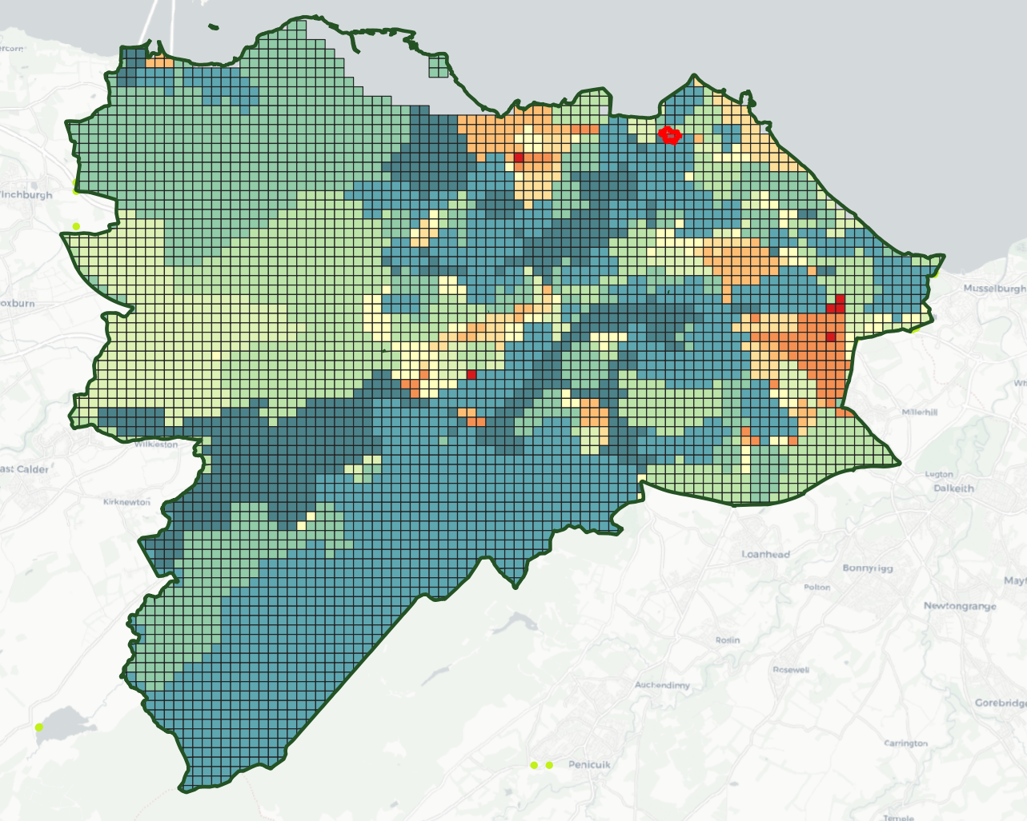
How do we know it’s clustering in a way we anticipated?
If you are interested in how to do this, please attend our Silent Disco!
For your convenience, there is a layer prepared already for you to import to QGIS. (Grid_treecount_simd)
Now we then have to plot them onto a graph to see if higher income bins have typically more trees.

Slide 22
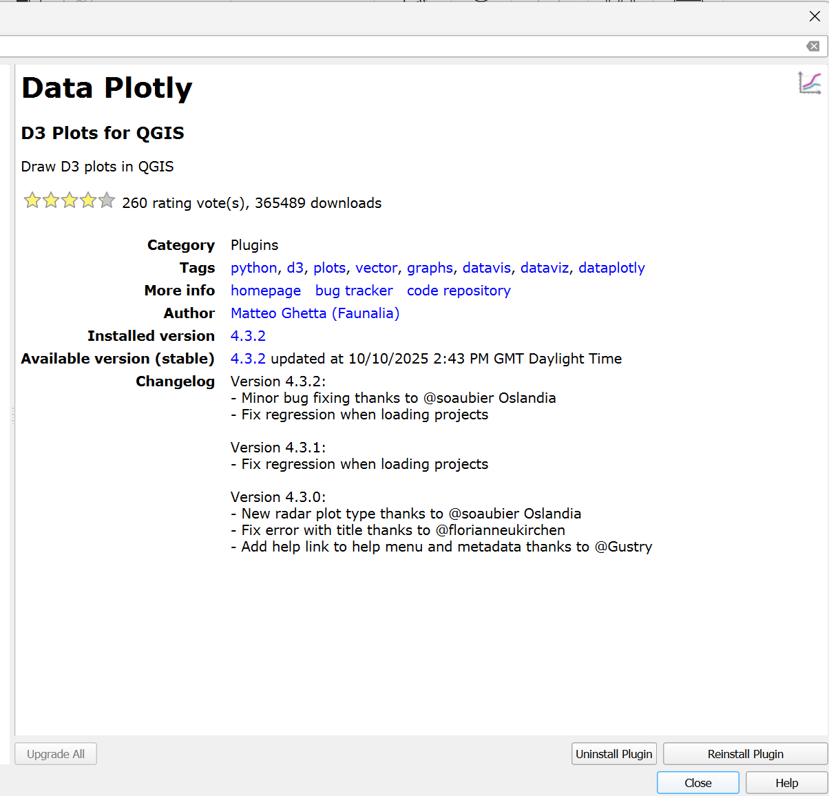
How do we know it’s clustering in a way we anticipated?
Install “Data Plotly” as a plugin

Slide 23
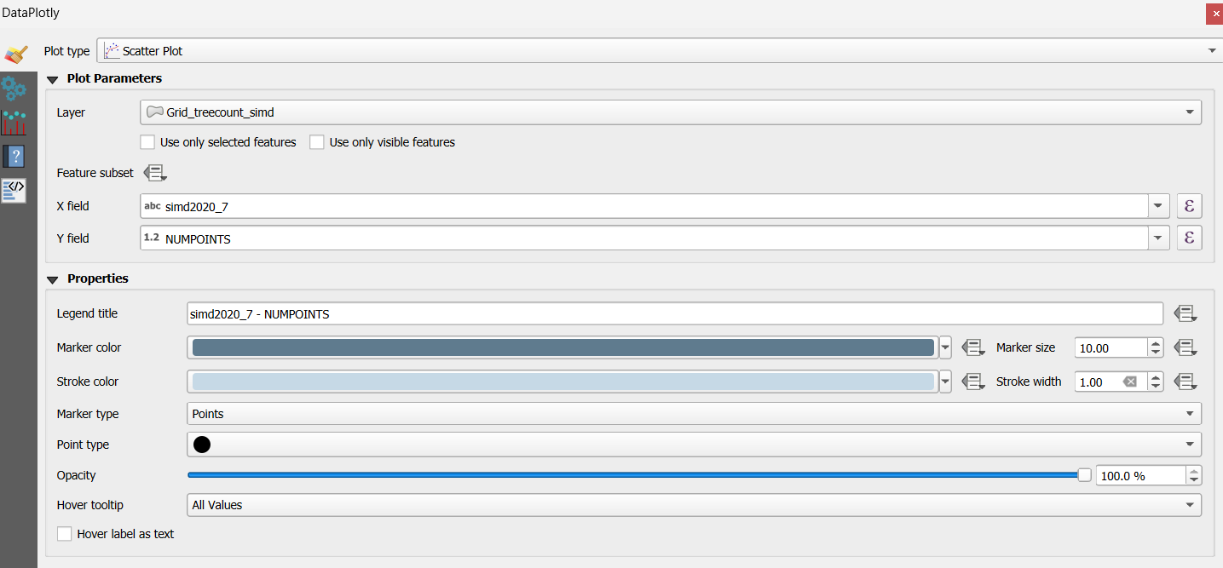
How do we know it’s clustering in a way we anticipated?
Layer = Grid_treecount_simd
X field = simd2020_7; Y field = NUMPOINTS

Slide 24
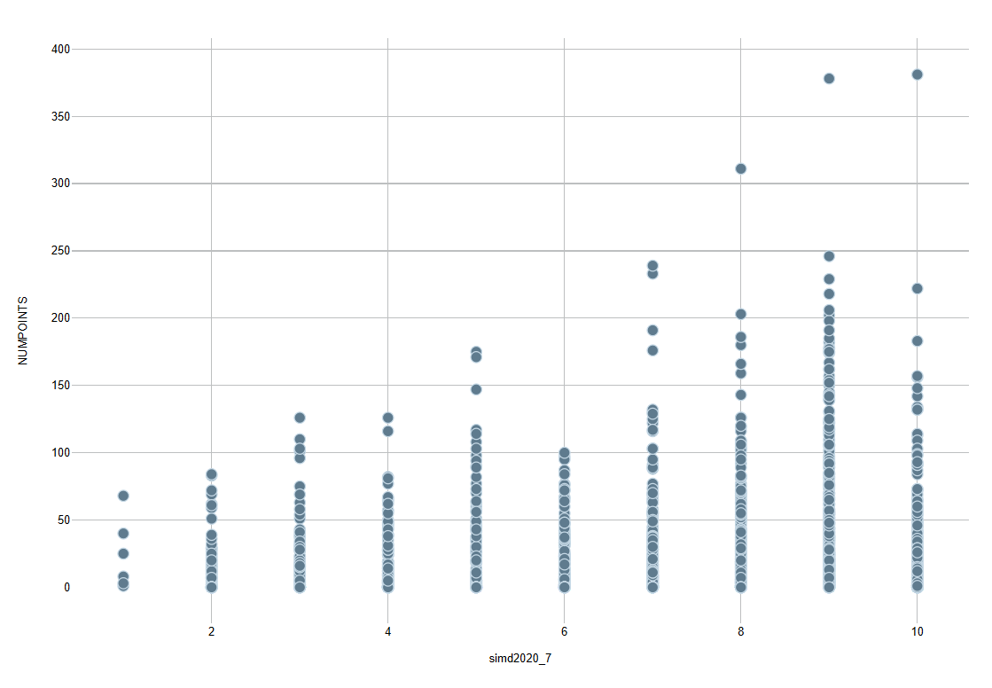
How do we know it’s clustering in a way we anticipated?
Decile 1-2 (Most Deprived): The "clusters" of points are hugged very tight to the bottom of the graph. Most quadrats in these areas have very few trees, rarely exceeding 50–75 per quadrat.
Decile 8-10 (Least Deprived): You see significant "vertical spikes." This indicates that while some areas still have few trees, the areas with the highest tree counts (reaching up to 350–400 per quadrat) are almost exclusively found in the least deprived deciles.
Agree with our expectations

Slide 25
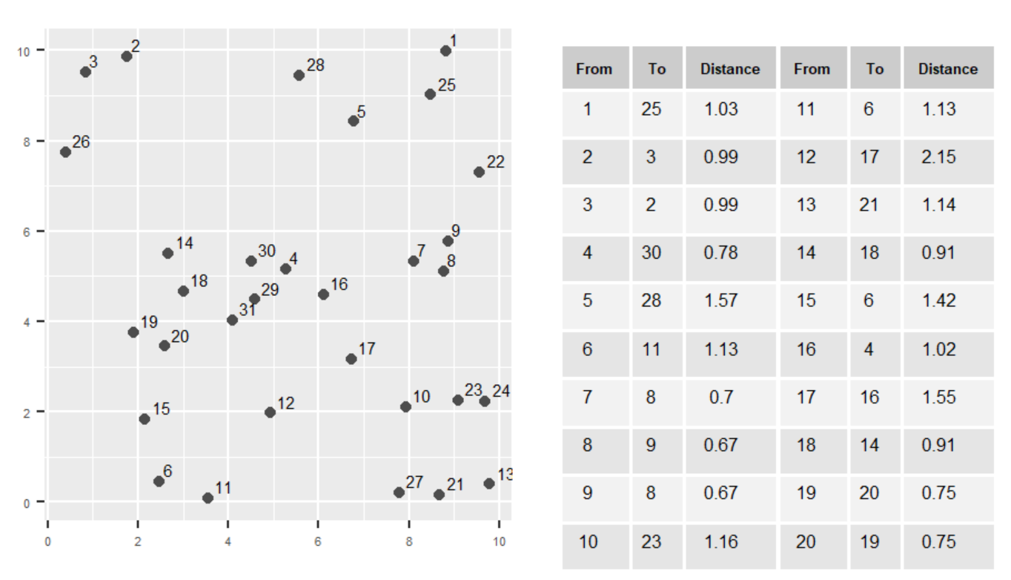
Nearest neighbour analysis
Distanced-based approach
Measures the average distance from each point in the study area to its nearest point

Slide 26
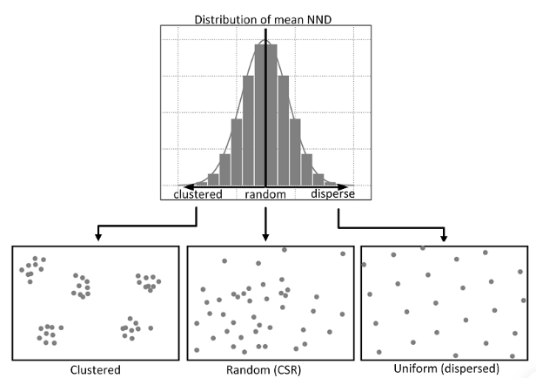
Nearest neighbour analysis
Distanced-based approach
Measures the average distance from each point in the study area to its nearest point
If this distance is lower than the average distance for a Poisson point process then we can say that our dataset is following a clustered pattern.
If the distance is bigger then the points are more spread than a Poisson point process so they are more dispersed.
What is a Poisson Point Process?
A series of points randomly located on a mathematical space with the essential feature that the points occur independently of one another.
Essentially a random distribution of points across our study area we can compare our real pattern to (a NULL hypothesis).
Notes:
What is a Poisson Point Process?
A series of points randomly located on a mathematical space with the essential feature that the points occur independently of one another.
Essentially a random distribution of points across our study area we can compare our real pattern to (a NULL hypothesis).

Slide 27
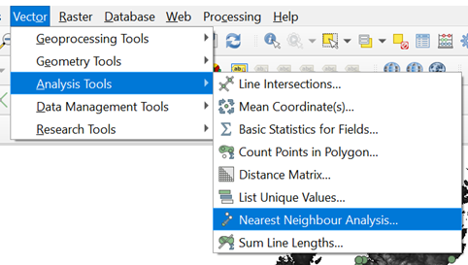
Let’s see how it works in QGIS
Load the shapefile into QGIS.
Navigate to Vector -> Analysis Tools -> Nearest Neighbour Analysis

Slide 28
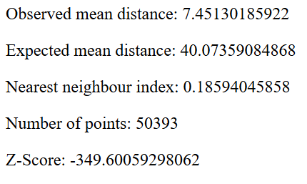
Nearest neighbour analysis
Mean distance between each incident of bike theft
The expected mean distance for a Poisson point process using the same number of points
Ratio between observed and expected mean distances
The statistical significance of NNI. It is the number of standard deviations that the Observed mean is distant from the Expected mean. The largest the distance (negative or positive) the more significant the result is. Anything above 2.5 or below -2.5 is considered significant.
Notes:
-1.96 and 1.96 mean random spatial pattern.

Slide 29
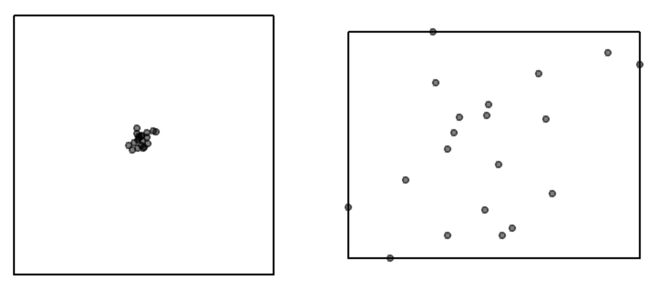
Problems of scale
The uncertainty inherent in data often means that we are not sure at what scale shall be analysing patterns.
Cases that appear clustered at one scale may dispersed at another.
Notes:
The same point pattern presented with two different study areas. How differently would you describe the point pattern in both cases?
The size and shape of the study area also have a very strong effect on this metric.

Slide 30
Ripley’s K-Function
Ripley’s K function looks at the distance between a point and ‘all distances’ to other points and automatically compare this to a Poisson-distribution point pattern.
Ripley’s K function essentially summarises the distance between points for all distances using radial distance bands.
Notes:
For example, for point S1 we draw circles, each of varying radius d , centered on that point. We then count the number of points (events) inside each circle. We repeat this for point S2 and all other points Si .
Next, we compute the average number of points in each circle then divide that number by the overall point density ^λ (i.e. total number of events per study area).

Slide 31
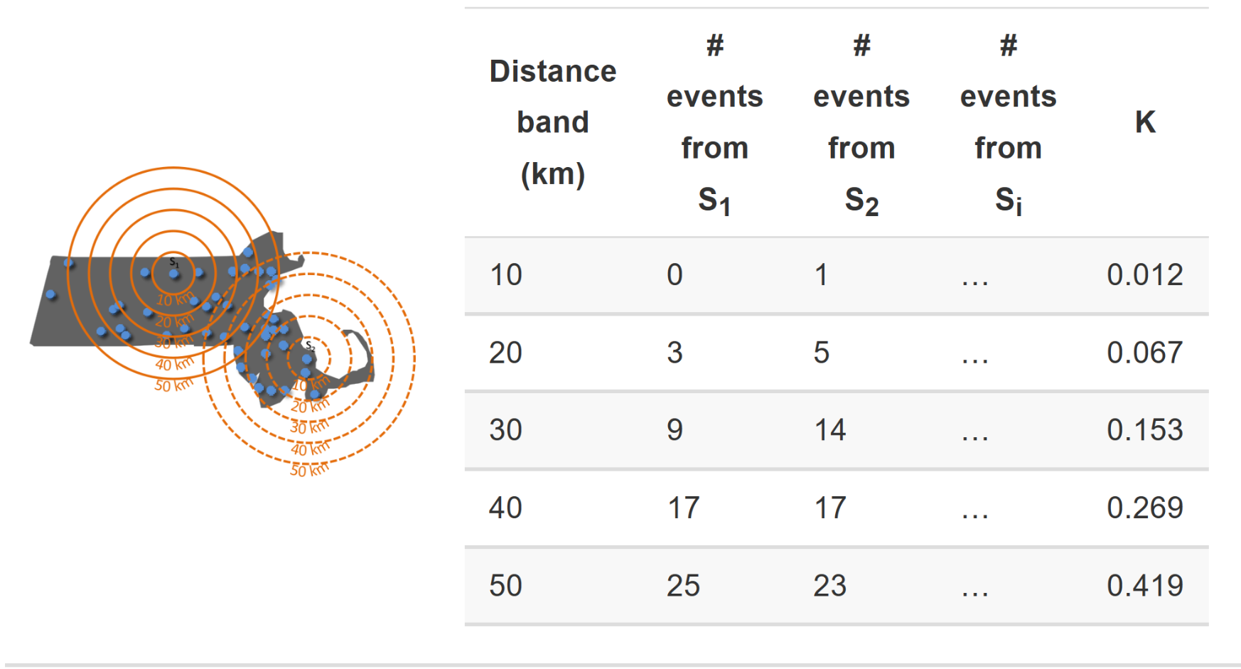
Ripley’s K-Function
For point S1, count the number of points inside a buffer (radius) of a certain size (10km). Then count the number of points inside a slightly larger buffer (20km). Continue until you reach the required buffer distance (i.e. 50km in this example).
Repeat this for S2 and all other points (Si) in the dataset.
Compute the average number of points in each buffer (radius) and divide this to the overall point density.
Repeat this using points drawn from a Poisson random model for the same set of buffers.
Compare the observed distribution with the distribution with the Poisson distribution.

Slide 32
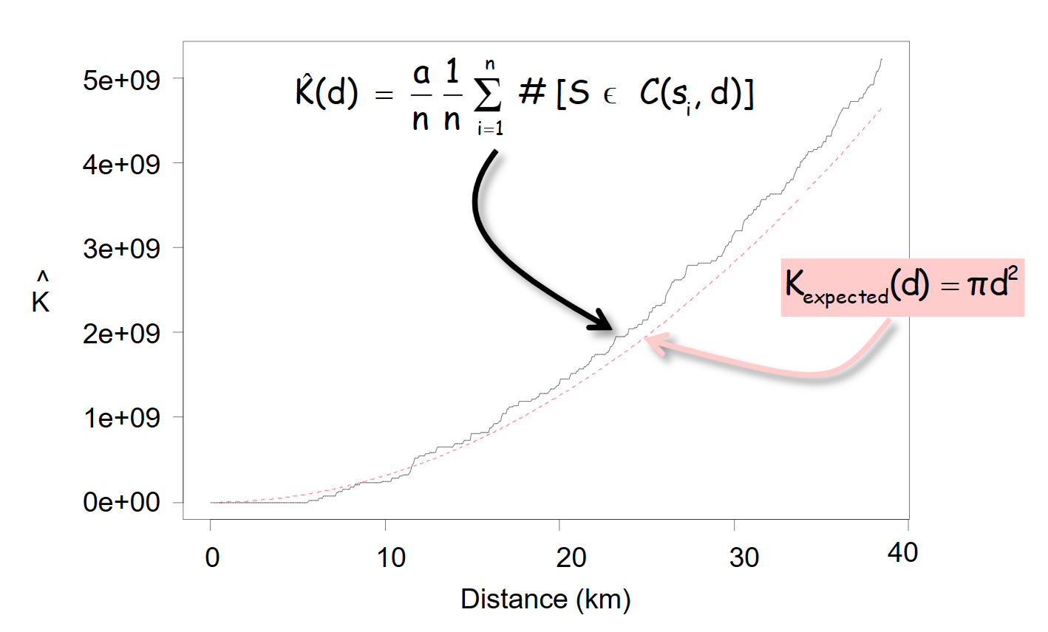
Ripley’s K-Function
Similar to NNA, a comparison of observed vs. expected distances (using a Poisson Point Process again) gives you the following information:
If the observed value is higher than the expected value, the events tend to cluster.
If the observed value is lower than the expected value, the events are dispersed.

Slide 33
Let’s see how it works in R
Please open the prepared R file.
Ensure to maintain the folder structure.

Slide 34
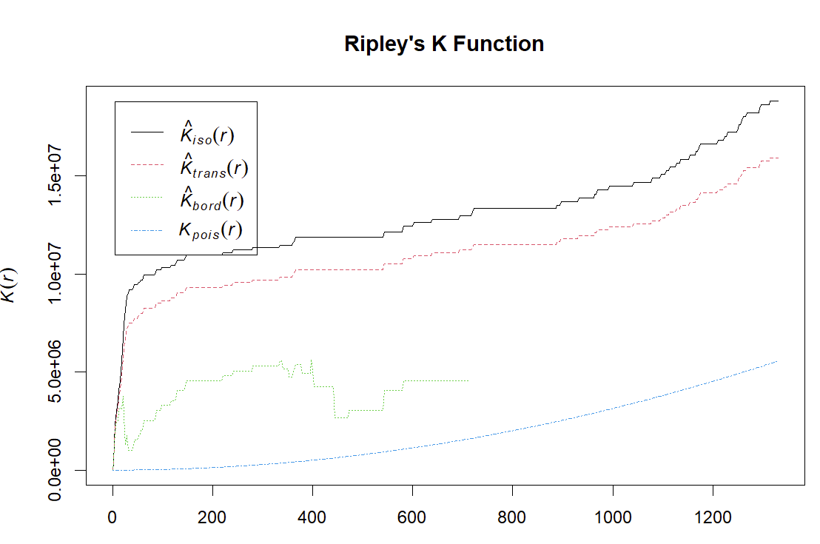
Ripley’s K-Function
•Kpois(r) - theoretical Poisson K(r)
•Kbord(r) - border-corrected estimate of K(r)
•Ktrans(r) - translation-corrected estimate of K(r)
•Kiso(r) - Ripley isotropic correction estimate of K(r)
Notes:
1. Statistical Significance Testing
The four methods are descriptive in nature; they calculate the observed K(r) values using different correction techniques but do not inherently provide a way to assess whether the observed pattern deviates significantly from randomness.
The envelope is created using Monte Carlo simulations under the null hypothesis of Complete Spatial Randomness (CSR). By comparing the observed K(r) values to the envelope, you can determine whether the pattern is significantly clustered or dispersed at different scales.
2. Accounting for Random Variation
Even with edge corrections, random variation can still influence the observed K(r). The envelope provides a range of expected values under CSR, helping to identify whether deviations in the observed pattern are due to random chance or meaningful spatial processes.
3. Multi-Scale Analysis
Ripley's KKK function analyzes spatial patterns across multiple distances (rrr). Patterns may vary at different scales (e.g., clustering at short distances but dispersion at long distances). The envelope allows you to evaluate these scale-dependent patterns by showing where the observed K(r)K(r)K(r) deviates from randomness at each distance.
4. Consistency Across Correction Methods
While different correction methods (e.g., border, translation, isotropic) address edge effects, they do not inherently provide a statistical framework for assessing significance. The envelope approach can be applied consistently across all correction methods to evaluate whether the observed pattern is statistically significant.
5. Visual Interpretation
The envelope aids in visualizing how the observed K(r) compares to a range of expected values under CSR. This makes it easier to interpret whether clustering or dispersion occurs and at what scales.

Slide 35
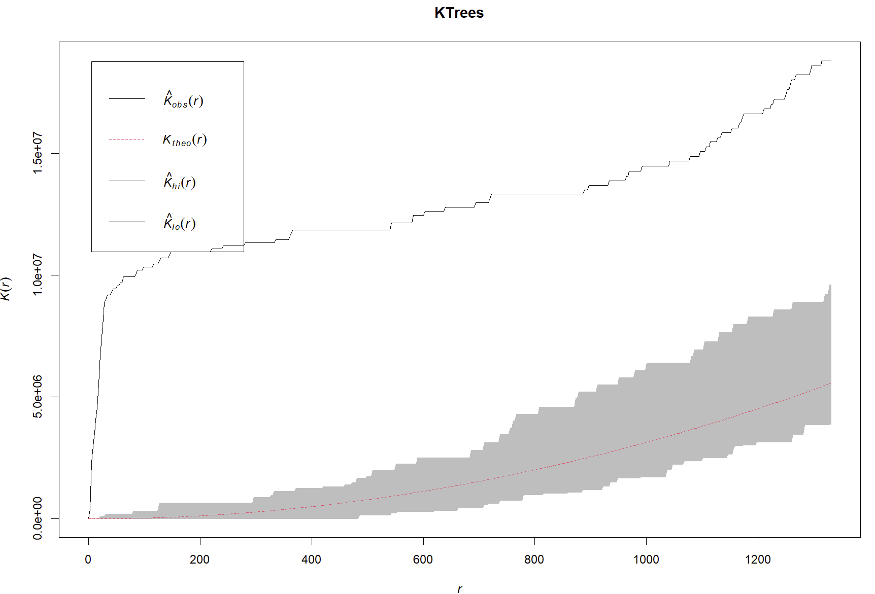
Ripley’s K-Function
Observed K(r) values above the envelope indicate higher than expected density at radius r → significant clustering
Observed K(r) values within the envelope indicate no significant deviation from sparseness.
Observed K(r) values below envelope = lower than expected density at radius r → significant sparseness
Results: Significantly clustered.
Notes:
#If the points are effective random, we would expect the observed line (black) to fall on top of or close to the theoretical line (blue).
Above the theoretical line indicates clustering; below indicates a regular or ordered distribution.
The green and red line represent K values calculated with different corrections for the border effect.
The translation correction is applied to address edge effects in the analysis of spatial patterns. When studying spatial point patterns within a bounded region (e.g., a study area with defined boundaries), the edge of the region can affect the estimation of the K(r) function. Points near the edge have fewer neighbors in one direction, leading to potential underestimation of clustering at larger distances. The translation correction involves adjusting the observed K(r) function to account for these edge effects. �trans(�)Ktrans​(r) is the translation-corrected estimate of the K(r) function, and it is expected to provide a more accurate representation of the underlying spatial pattern by mitigating the impact of edge effects.
When analyzing point patterns within a region, the behavior of points near the boundary can lead to biased estimates of the spatial statistics. The Kbord​(r) function aims to correct for these edge effects and provide a more accurate representation of the spatial distribution of points.
The border correction is particularly relevant when studying point patterns in areas with well-defined boundaries or when the study region is limited. In such cases, points near the border have fewer neighbors in one direction, which can affect the estimation of the K(r) function. If left uncorrected, this can lead to an underestimation of clustering at larger distances. The Kbord​(r) function adjusts the observed K(r) function to account for the influence of the boundary, thereby providing a more reliable characterization of the spatial pattern within the study area.

Slide 36
Reference
First and Second Order Processes:
https://mgimond.github.io/Spatial/chp11_0.html#first-and-second-order-effects
Kernel Density Estimate:
https://pro.arcgis.com/en/pro-app/latest/tool-reference/spatial-analyst/how-kernel-density-works.htm
https://mathisonian.github.io/kde/
Nearest Neighbour Analysis:
https://pro.arcgis.com/en/pro-app/latest/tool-reference/spatial-statistics/h-how-average-nearest-neighbor-distance-spatial-st.htm
Ripley’s K-Function:
https://www.statisticshowto.com/k-function-ripleys/
https://pro.arcgis.com/en/pro-app/latest/tool-reference/spatial-statistics/h-how-multi-distance-spatial-cluster-analysis-ripl.htm#:~:text=Ripley's%20K%2Dfunction%20illustrates%20how,distance%20and%2For%20distance%20increment.
https://cran.r-project.org/web/packages/spNetwork/vignettes/KNetworkFunctions.html

Slide 37
Thank you

